Slide 1
Organizational Structure and Design
Chapter
10
© 2007 Prentice Hall, Inc.
All rights reserved.

Slide 2
L E A R N I N G O U T L I N E
Follow this Learning Outline as you read and study this chapter.
Defining Organizational Structure
  Discuss the traditional and contemporary views of work specialization, chain of command, and span of control.
  Describe each of the five forms of departmentalization.
  Explain cross-functional teams.
  Differentiate, authority, responsibility, and unity of command.
  Tell what factors influence the amount of centralization and decentralization.
  Explain how formalization is used in organizational design.
© 2007 Prentice Hall, Inc. All rights reserved.
10–<number>

Slide 3
L E A R N I N G O U T L I N E (cont’d)
Follow this Learning Outline as you read and study this chapter.
Organizational Design Decisions
  Contrast mechanistic and organic organizations.
  Explain the relationship between strategy and structure.
  Tell how organizational size affects organizational design.
  Discuss Woodward’s findings on the relationship of technology and structure.
  Explain how environmental uncertainty affects organizational design.
© 2007 Prentice Hall, Inc. All rights reserved.
10–<number>

Slide 4
L E A R N I N G O U T L I N E (cont’d)
Follow this Learning Outline as you read and study this chapter.
Common Organizational Designs
  Contrast the three traditional organizational designs.
  Explain team, matrix, and project structures.
  Describe the design of virtual and network organizations.
  Discuss the organizational design challenges facing managers today.
© 2007 Prentice Hall, Inc. All rights reserved.
10–<number>

Slide 5
Defining Organizational Structure
Organizational Structure
  The formal arrangement of jobs within an organization.
  Rules and regulations, how jobs are defined, and an authority chain of command.
  Example:
  CEO
  ↓
  VP of Marketing
  ↓
  Marketing Manager
  ↓
  Marketing Team Members
© 2007 Prentice Hall, Inc. All rights reserved.
10–<number>

Slide 6
1. Traditional Hierarchical Structure
CEO
|
----------------------------------
| | |
VP Operations VP Marketing VP Finance
| | |
Managers Managers Managers
| | |
Employees Employees Employees
Functional departments
Set of formal rules
Clear chain of command
Top-down decision-making
CEO
|
-----------------------
| | |
Squad Squad Squad
1 2 3
(9 people) (9 people) (9 people)
| | |
Cross-functional autonomous teams
(Handle end-to-end customer responsibilities)
2. ING’s (Dutch banking firm )
Free-Form Structure
Flat hierarchy
Minimizes the number of managers
Relies on small teams to get the work done
ING has replaced its functional departments with
350 nine-person autonomous teams
End-to-end responsibility for handling clients’ needs
© 2007 Prentice Hall, Inc. All rights reserved.
1–<number>

Slide 7
Cont.……
The company credits this new structure with improved response speed, increased employee engagement, and higher productivity.
© 2007 Prentice Hall, Inc. All rights reserved.
1–<number>

Slide 8
SIX elements of organizational design
Organizational Design:
  “Creating or changing an organization’s structure”
  A process involving decisions about six key elements:
    Work specialization
    Departmentalization
    Chain of command
    Span of control
    Centralization and decentralization
    Formalization
    Organizational chart:
“The visual representation of an organization’s structure”
© 2007 Prentice Hall, Inc. All rights reserved.
10–<number>

Slide 9

Organizational Structure
Work Specialization (division of labor)
“Dividing work activities into separate job tasks”
The degree to which tasks in the organization are divided into separate jobs. The essence of work specialization is to divide a job into several steps, each completed by a separate individual.
© 2007 Prentice Hall, Inc. All rights reserved.
10–<number>

Slide 10
What is Specialization?
Specialization means dividing work into smaller tasks and assigning each task to the person best suited to do it.
Why It’s Useful:
Employees focus on one specific task, so they get faster and better at it through practice.
Less time is wasted switching between tasks or tools.
People use their skills more efficiently — skilled workers do complex tasks, and simpler tasks are handled by others.
This helps the company save money and increase productivity.
© 2007 Prentice Hall, Inc. All rights reserved.
1–<number>

Slide 11
Henry Ford's Assembly Line (Early 20th Century)
Before Ford: Traditional Car Production
👨‍🔧 Skilled workers built entire cars
🕒 Time-consuming and expensive
🛠️ Custom-built, low output
🔧 Ford's Innovation: The Assembly Line
➡️ Work Breakdown Example:
Every worker was assigned a specific repetitive task, such as putting on the right front wheel or installing the left front door.
Instead of one person doing everything, each person does one job repeatedly, becoming more efficient.
© 2007 Prentice Hall, Inc. All rights reserved.
1–<number>

Slide 12
Result:
Ford was able to produce a car every ten seconds, using employees with relatively limited skills.
🚘 Cars became affordable to the average person
📈 Ford became extremely wealthy
🏭 Revolutionized manufacturing worldwide.
© 2007 Prentice Hall, Inc. All rights reserved.
1–<number>

Slide 13
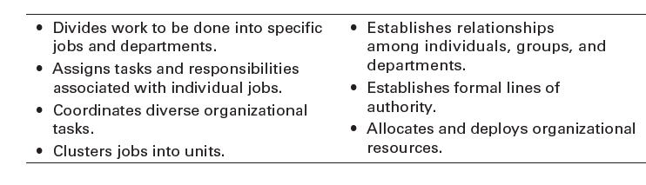
Exhibit 10–1 Purposes of Organizing
© 2007 Prentice Hall, Inc. All rights reserved.
10–<number>

Slide 14
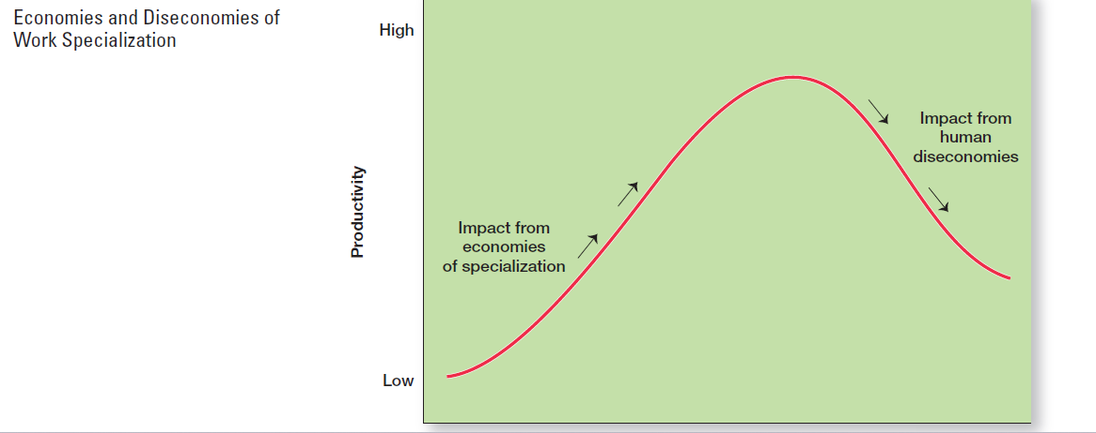
© 2007 Prentice Hall, Inc. All rights reserved.
1–<number>

Slide 15
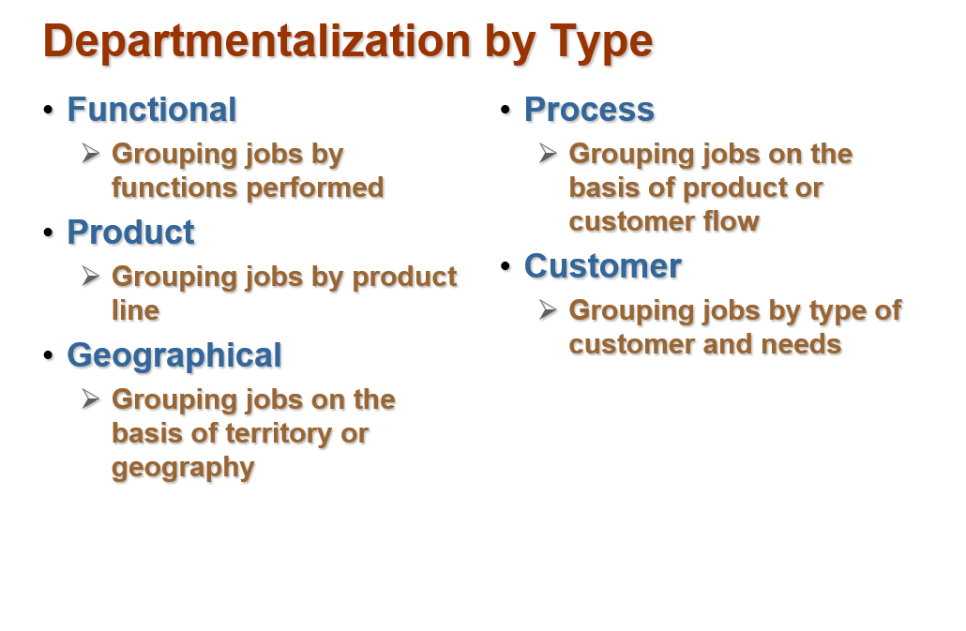
Departmentalization
“The basis by which jobs are grouped together.”
© 2007 Prentice Hall, Inc. All rights reserved.
1–<number>

Slide 16
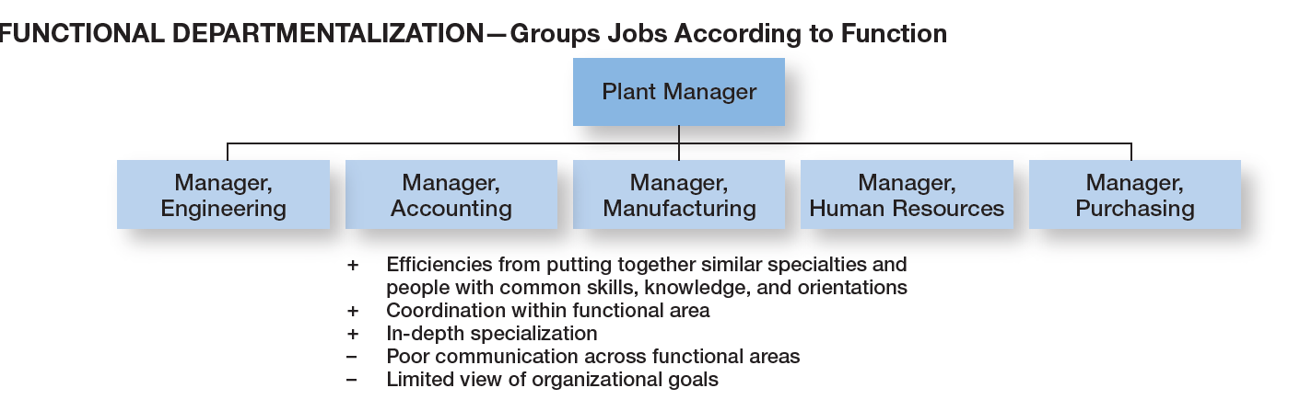
Exhibit 10–2 Functional Departmentalization
© 2007 Prentice Hall, Inc. All rights reserved.
10–<number>

Slide 17
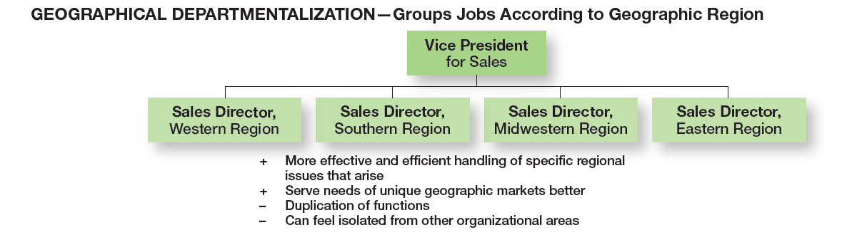
Exhibit 10–2 (cont’d) Geographical Departmentalization
© 2007 Prentice Hall, Inc. All rights reserved.
10–<number>

Slide 18
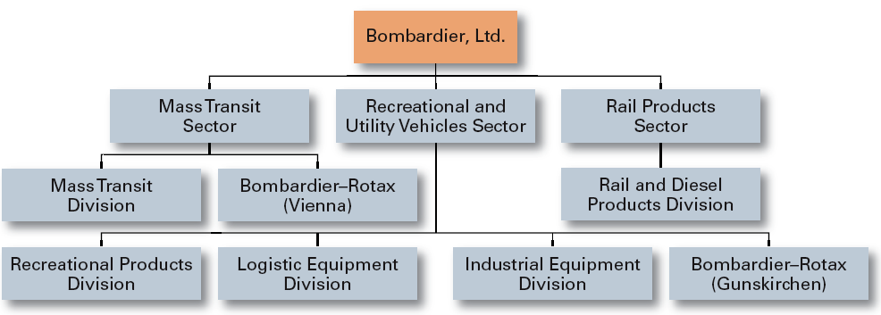
Exhibit 10–2 (cont’d) Product Departmentalization
+ Allows specialization in particular products and services
+ Managers can become experts in their industry
+ Closer to customers
– Duplication of functions
– Limited view of organizational goals
© 2007 Prentice Hall, Inc. All rights reserved.
10–<number>

Slide 19
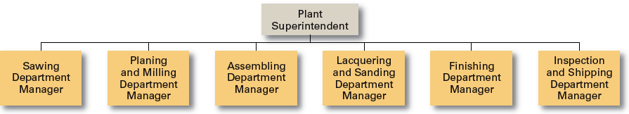
Exhibit 10–2 (cont’d) Process Departmentalization
+ More efficient flow of work activities
– Can only be used with certain types of products
© 2007 Prentice Hall, Inc. All rights reserved.
10–<number>

Slide 20
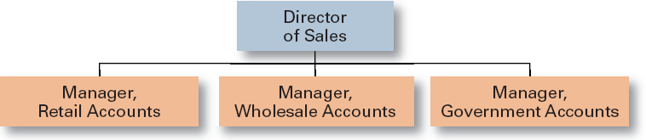
Exhibit 10–2 (cont’d) Customer Departmentalization
+ Customers’ needs and problems can be met by specialists
- Duplication of functions
- Limited view of organizational goals
© 2007 Prentice Hall, Inc. All rights reserved.
10–<number>

Slide 21

Organization Structure (cont’d)
Chain of Command
  The continuous line of authority that extends from upper levels of an organization to the lowest levels of the organization and clarifies who reports to who.
© 2007 Prentice Hall, Inc. All rights reserved.
10–<number>

Slide 22
Organization Structure (cont’d)
Authority
  The rights inherent in a managerial position to tell people what to do and to expect them to do it.
Responsibility
  The obligation or expectation to perform.
Unity of Command
  The concept that a person should have one boss and should report only to that person.
Line authority
  Authority that entitles a manager to direct the work of an employee
© 2007 Prentice Hall, Inc. All rights reserved.
10–<number>

Slide 23
Organization Structure (cont’d)
Span of Control
  The number of employees who can be effectively and efficiently supervised by a manager.
  Width of span is affected by:
    Skills and abilities of the manager
    Employee characteristics
    Characteristics of the work being done
    Similarity of tasks
    Complexity of tasks
    Physical proximity of subordinates
    Standardization of tasks
© 2007 Prentice Hall, Inc. All rights reserved.
10–<number>

Slide 24
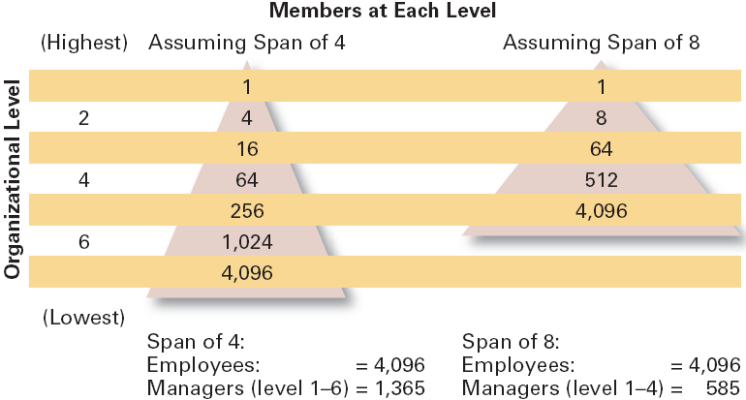
Exhibit 10–3 Contrasting Spans of Control
© 2007 Prentice Hall, Inc. All rights reserved.
10–<number>

Slide 25
Exhibit 11-4 Explanation
This exhibit compares two organizational structures that both manage 4,096 employees, but with different spans of control:
Organizational Level | Span of 4 | Span of 8
1 (Top-level manager) | 1 | 1
2 | 4 | 8
3 | 16 | 64
4 | 64 | 512
5 | 256 | 4,096
6 | 1,024 | -
7 (Lowest level) | 4,096 | -
Cost Savings:
Each manager earns $85,000 per year.
780 managers × $85,000 = $66.3 million saved annually (the text rounds this up to $68M).
✅ Result: Massive cost efficiency with wider span.
© 2007 Prentice Hall, Inc. All rights reserved.
1–<number>

Slide 26
Organization Structure (cont’d)
Centralization
  The degree to which decision-making is concentrated at a single point in the organizations.
    Organizations in which top managers make all the decisions and lower-level employees simply carry out those orders.
Decentralization
  Organizations in which decision-making is pushed down to the managers who are closest to the action.
Employee Empowerment
  Increasing the decision-making authority (power) of employees.
© 2007 Prentice Hall, Inc. All rights reserved.
10–<number>

Slide 27
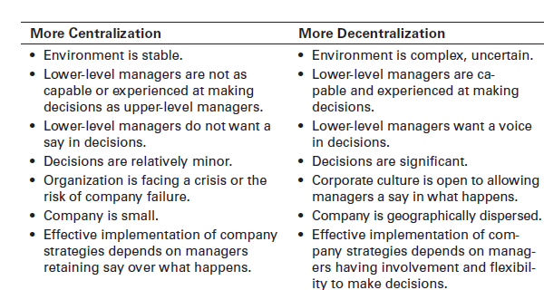
Exhibit 10–4 Factors that Influence the Amount of Centralization
© 2007 Prentice Hall, Inc. All rights reserved.
10–<number>

Slide 28
Organization Structure (cont’d)
Formalization
  The degree to which jobs within the organization are standardized and the extent to which employee behavior is guided by rules and procedures.
    Highly formalized jobs offer little discretion over what is to be done.
    Low formalization means fewer constraints on how employees do their work.
© 2007 Prentice Hall, Inc. All rights reserved.
10–<number>

Slide 29
Organizational Design Decisions
Mechanistic Organization
  A rigid and tightly controlled structure
    High specialization
    Rigid departmentalization
    Narrow spans of control
    High formalization
    Limited information network (downward)
    Low decision participation
Organic Organization
  Highly flexible and adaptable structure
    Non-standardized jobs
    Fluid team-based structure
    Little direct supervision
    Minimal formal rules
    Open communication network
    Empowered employees
© 2007 Prentice Hall, Inc. All rights reserved.
10–<number>

Slide 30
Example: Google (R&D Division)
Google’s Research & Development (R&D) division is a great example of an organic organization because:
Flexible & Adaptable Structure: Teams can quickly reorganize when a new project idea emerges.
Non-standardized Jobs: A software engineer may do coding, testing, brainstorming, and even product design.
Fluid Team-based Work: Employees work in cross-functional teams (engineers, designers, marketers) to develop products like Gmail or Google Maps.
Little Direct Supervision: Managers act as facilitators instead of micromanagers; employees self-manage tasks.
Minimal Formal Rules: Innovation is encouraged, so there are no rigid step-by-step instructions for creativity.
Open Communication: Employees can directly share ideas across levels—even junior engineers can pitch to senior leaders.
Empowered Employees: Workers are given autonomy to experiment (like the famous “20% rule” where employees spend part of their time on personal innovation projects).
📌 Result: Products like Gmail, Google News, and Google Maps were born from this flexible, employee-driven structure.
© 2007 Prentice Hall, Inc. All rights reserved.
1–<number>

Slide 31
Example: McDonald’s (Global Operations)
McDonald’s is a mechanistic organization because:
Rigid and Tightly Controlled Structure: Every restaurant follows the same global operating model.
High Specialization: Roles are narrowly defined (cashier, fry cook, burger assembler).
Rigid Departmentalization: Kitchen, counter, and management are clearly separated.
Narrow Span of Control: Supervisors closely monitor employees to ensure standards are followed.
High Formalization: Detailed Standard Operating Procedures (SOPs) govern how food is cooked, served, and packaged.
Limited Communication Network (Downward): Instructions come from corporate HQ and managers; employees mainly follow orders.
Low Decision Participation: Individual employees cannot change menus or policies—they must strictly follow the system.
📌 Result: McDonald’s achieves efficiency, consistency, and quality control worldwide—customers get the same Big Mac whether they’re in New York, Paris, or Karachi.
© 2007 Prentice Hall, Inc. All rights reserved.
1–<number>

Slide 32


Exhibit 10–5 Mechanistic versus Organic Organization
• High specialization
• Rigid departmentalization
• Clear chain of command
• Narrow spans of control
• Centralization
• High formalization
• Cross-functional teams
• Cross-hierarchical teams
• Free flow of information
• Wide spans of control
• Decentralization
• Low formalization
© 2007 Prentice Hall, Inc. All rights reserved.
10–<number>

Slide 33
Contingency Factors
Structural decisions are influenced by:
  Overall strategy of the organization
    Organizational structure follows strategy.
  Size of the organization
    Firms change from organic to mechanistic organizations as they grow in size.
  Technology use by the organization
    Firms adapt their structure to the technology they use.
  Degree of environmental uncertainty
    Dynamic environments require organic structures; mechanistic structures need stable environments.
© 2007 Prentice Hall, Inc. All rights reserved.
10–<number>

Slide 34
Contingency Factors (cont’d)
Strategy Frameworks:
  Innovation
    Pursuing competitive advantage through meaningful and unique innovations favors an organic structuring.
  Cost minimization
    Focusing on tightly controlling costs requires a mechanistic structure for the organization.
  Imitation
    Minimizing risks and maximizing profitability by copying market leaders requires both organic and mechanistic elements in the organization’s structure.
© 2007 Prentice Hall, Inc. All rights reserved.
10–<number>

Slide 35
Contingency Factors (cont’d)
Strategy and Structure
  Achievement of strategic goals is facilitated by changes in organizational structure that accommodate and support change.
Size and Structure
  As an organization grows larger, its structure tends to change from organic to mechanistic with increased specialization, departmentalization, centralization, and rules and regulations.
© 2007 Prentice Hall, Inc. All rights reserved.
10–<number>

Slide 36
Contingency Factors (cont’d)
Technology and Structure
Every organization uses technology to convert inputs → outputs (e.g., raw material → finished goods).
The type of technology influences the organizational structure (mechanistic vs organic).
👉 In short: Routine technology = mechanistic structure
Non-routine/complex technology = organic structure
© 2007 Prentice Hall, Inc. All rights reserved.
10–<number>

Slide 37
Joan Woodward’s Research
Joan Woodward studied manufacturing firms and found that the type of production technology determines the most effective structure.
Categories of Technology:
Unit Production
  Produces items in small batches or single units.
  Non-routine, customized work → needs organic structure.
Mass Production
  Produces large batches of standardized products.
  Routine, repetitive work → needs mechanistic structure.
Process Production
  Continuous, highly technical processes.
  Very complex technology → often mechanistic at the technical level, but requires organic coordination to handle problems.
© 2007 Prentice Hall, Inc. All rights reserved.
1–<number>

Slide 38
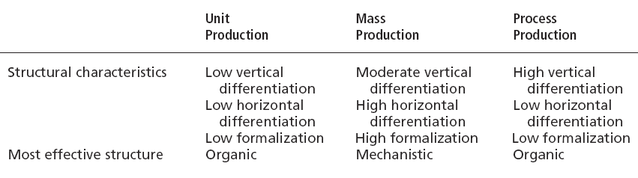
Exhibit 10–6 Woodward’s Findings on Technology, Structure, and Effectiveness
© 2007 Prentice Hall, Inc. All rights reserved.
10–<number>

Slide 39

Contingency Factors (cont’d)
Environmental Uncertainty and Structure
  Mechanistic organizational structures tend to be most effective in stable and simple environments.
  The flexibility of organic organizational structures is better suited for dynamic and complex environments.
© 2007 Prentice Hall, Inc. All rights reserved.
10–<number>

Slide 40
Common Organizational Designs
Traditional Designs
  Simple structure
    Low departmentalization, wide spans of control, centralized authority, little formalization
  Functional structure
    Departmentalization by function
      Operations, finance, human resources, and product research and development
  Divisional structure
    Composed of separate business units or divisions with limited autonomy under the coordination and control the parent corporation.
© 2007 Prentice Hall, Inc. All rights reserved.
10–<number>

Slide 41
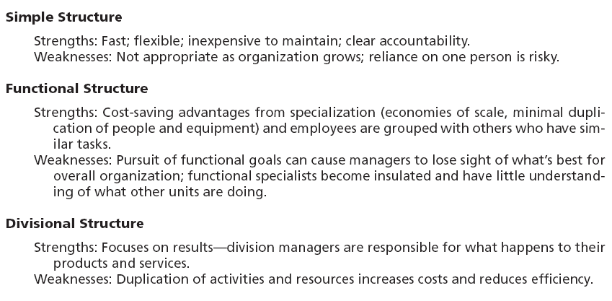
Exhibit 10–7 Strengths and Weaknesses of Traditional Organizational Designs
© 2007 Prentice Hall, Inc. All rights reserved.
10–<number>

Slide 42
Exhibit 10–8 Contemporary Organizational Designs
Team Structure
• What it is: | A structure in which the entire organization is made up of work groups or teams.
• Advantages: | Employees are more involved and empowered. Reduced barriers among functional areas.
• Disadvantages: | No clear chain of command. Pressure on teams to perform.
Matrix-Project Structure
What it is: | A structure that assigns specialists from different functional areas to work on projects but who return to their areas when the project is completed. Project is a structure in which employees continuously work on projects. As one project is completed, employees move on to the next project.
• Advantages: | Fluid and flexible design that can respond to environmental changes. Faster decision making.
• Disadvantages: | Complexity of assigning people to projects. Task and personality conflicts.
© 2007 Prentice Hall, Inc. All rights reserved.
10–<number>

Slide 43
Exhibit 10–8 (cont’d) Contemporary Organizational Designs
Boundaryless Structure
What it is: | A structure that is not defined by or limited to artificial horizontal, vertical, or external boundaries; includes virtual and network types of organizations.
• Advantages: | Highly flexible and responsive. Draws on talent wherever it’s found..
• Disadvantages: | Lack of control. Communication difficulties..
© 2007 Prentice Hall, Inc. All rights reserved.
10–<number>

Slide 44
Organizational Designs (cont’d)
Contemporary Organizational Designs
  Team structures
    The entire organization is made up of work groups or self-managed teams of empowered employees.
  Matrix and project structures
    Specialists from different functional departments are assigned to work on projects led by project managers.
    Matrix and project participants have two managers.
    In project structures, employees work continuously on projects; moving on to another project as each project is completed.
© 2007 Prentice Hall, Inc. All rights reserved.
10–<number>

Slide 45
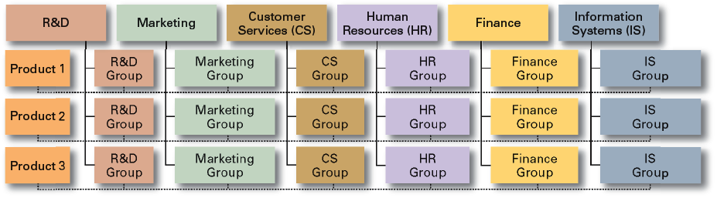
Exhibit 10–9 An Example of a Matrix Organization
© 2007 Prentice Hall, Inc. All rights reserved.
10–<number>

Slide 46
Example:
Real-World Example:
Let’s say a tech company develops three main software products:
Product 1: A messaging app
Product 2: A cloud storage service
Product 3: A project management tool
Now, each product needs help from multiple departments. For instance:
For Product 1 (Messaging App):
R&D Group: Develops new features like video calling.
Marketing Group: Runs ad campaigns targeting students.
CS Group: Handles support tickets for login issues.
HR Group: Hires more developers for this product.
Finance Group: Tracks budgets, revenue, and costs for the app.
IS Group: Ensures the app’s infrastructure runs smoothly.
Each functional group focuses on Product 1, while similar groups focus on Product 2 and Product 3.
© 2007 Prentice Hall, Inc. All rights reserved.
1–<number>

Slide 47
Organizational Designs (cont’d)
Contemporary Organizational Designs (cont’d)
  Boundaryless Organization
    An flexible and unstructured organizational design that is intended to break down external barriers between the organization and its customers and suppliers.
    Removes internal (horizontal) boundaries:
      Eliminates the chain of command
      Has limitless spans of control
      Uses empowered teams rather than departments
    Eliminates external boundaries:
      Uses virtual, network, and modular organizational structures to get closer to stakeholders.
© 2007 Prentice Hall, Inc. All rights reserved.
10–<number>

Slide 48
Removing External Boundaries
Virtual Organization
  An organization that consists of a small core of full-time employees and that temporarily hires specialists to work on opportunities that arise.
Network Organization
  A small core organization that outsources its major business functions (e.g., manufacturing) in order to concentrate what it does best.
Modular Organization
  A manufacturing organization that uses outside suppliers to provide product components for its final assembly operations.
© 2007 Prentice Hall, Inc. All rights reserved.
10–<number>

Slide 49
Today’s Organizational Design Challenges
Keeping Employees Connected
  Widely dispersed and mobile employees
Building a Learning Organization
Managing Global Structural Issues
  Cultural implications of design elements
© 2007 Prentice Hall, Inc. All rights reserved.
10–<number>

Slide 50
Organizational Designs (cont’d)
The Learning Organization
  An organization that has developed the capacity to continuously learn, adapt, and change through the practice of knowledge management by employees.
  Characteristics of a learning organization:
    An open team-based organization design that empowers employees
    Extensive and open information sharing
    Leadership that provides a shared vision of the organization’s future, support and encouragement
    A strong culture of shared values, trust, openness, and a sense of community.
© 2007 Prentice Hall, Inc. All rights reserved.
10–<number>

Slide 51
Terms to Know
organizing
organizational structure
organizational design
work specialization
departmentalization
functional departmentalization
product departmentalization
geographical departmentalization
process departmentalization
customer departmentalization
cross-functional teams
chain of command
authority
responsibility
unity of command
span of control
centralization
decentralization
employee empowerment
formalization
mechanistic organization
organic organization
unit production
mass production
process production
simple structure
functional structure
© 2007 Prentice Hall, Inc. All rights reserved.
10–<number>

Slide 52
Terms to Know
divisional structure
team structure
matrix structure
project structure
boundaryless organization
virtual organization
network organization
learning organization
organizational chart
© 2007 Prentice Hall, Inc. All rights reserved.
10–<number>

